Slide 1

A TAPESTRY OF MEMORIES: WEAVING MY LIFE'S STORIES
Life is a fascinating journey filled with twists, turns, and unforgettable moments. As I look back on my own path, I am reminded of the diverse experiences that have shaped me into the person I am today. This autobiography is a glimpse into my life, a collection of moments and mosaics that have left an indelible mark on me and those around me.

Slide 2
MY AUTOBIOGRAPHY
1
Early Years
My name is Immaculate Mwihaki Njeri. I was born on August 21, 2003, in Kiambu County, Kenya. I am a 21-year-old currently living in Kiambu. My mother is Virginia Njeri Kamau. I am the second born in our family, with a younger brother, Dennis Kamau, and an older sister, Catherine Nyakiringa, making a nuclear family of four. I was born in the then Lari district, at Kijabe Hospital.
2
Harmonious Childhood
My early years were characterized by a harmonious upbringing, rich in the bonds of family, friendships, and a strong sense of community. Growing up in a close-knit village, life was simple, and the values of unity and togetherness were deeply ingrained. I used to spend most of my time with my grandparents, to whom we were very close.
3
Life with Cousins and Childhood Friends
I was fortunate to have cousins and childhood friends as neighbors. We shared a unique camaraderie that added a special dimension to my upbringing. Together, we explored the village, climbed trees, played games in open fields, and embarked on countless adventures. Our friendships were forged in the laughter and joy of carefree days, forming bonds that would last a lifetime.
4
Playtime in the Village Playgrounds
Our village had its share of playgrounds, which were the epicenter of our youthful joy. These open spaces became our canvas for creativity, imagination, and endless games. From playing tag to organizing mini-sports events, these playgrounds were where we learned the values of teamwork, sportsmanship, and the exhilaration of friendly competition.
5
Helping Our Parents
In our close-knit community, it was common for children to assist their parents with daily chores. I eagerly helped my parents with household tasks, such as fetching water from the communal well, tending to the garden, and caring for our animals. These responsibilities instilled in me a sense of responsibility and taught me the importance of contributing to the well-being of the family.
6
Taking Care of My Younger Brother
As the older sibling, I was entrusted with caring for my brother. It was a role I embraced wholeheartedly. I watched over him, played with him, and assisted with his needs. This experience not only taught me the value of patience and empathy but also deepened the bonds within our family.
7
Simple Pleasures of Village Life
Life in the village was a tapestry of simple pleasures. We enjoyed storytelling sessions under the starry night sky, participated in cultural festivals, and celebrated traditional holidays with fervor. These experiences nurtured an appreciation for our heritage and instilled a sense of belonging to the rich tapestry of our village life.

Slide 3
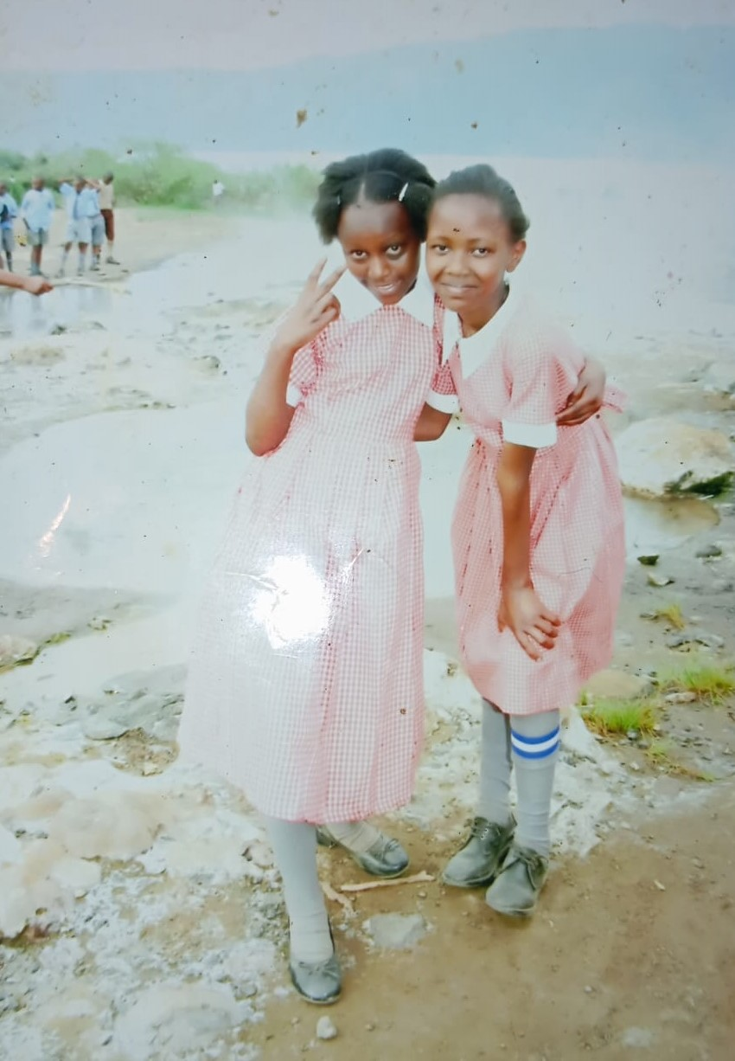
CHAPTER 1: EARLY YEARS
1
Childhood Memories
Growing up, I have many fond memories of my childhood that have shaped me into the person I am today. I remember the joy of playing with my sister, brother, and friends, exploring the world around us, and discovering new things.
2
Challenges and Growth
I also remember the challenges that came with growing up, such as the pressure to perform well in school, the struggles of navigating social dynamics, and the occasional conflicts with my siblings. However, these challenges taught me valuable lessons about resilience, perseverance, and the importance of seeking help when needed.
3
Fond Memories with Grandparents
One of my fondest childhood memories is the time I spent with my grandparents in Gitogothi, Limuru. I would spend my holidays with them, playing games with local children in the afternoons and listening to my grandparents' stories in the evenings. These experiences taught me the importance of family, community, and tradition.
4
Community Service
Another memorable experience from my childhood is the time I spent participating in community service activities. I was part of a local youth group that organized community clean-ups, visited the elderly, and provided support to those in need. These experiences taught me the importance of giving back to the community and the value of service.

Slide 4

Conclusion
Early Years
Overall, my early years were a time of innocence, friendships, and the beauty of village life. The friendships I formed, the experiences I shared with cousins and childhood friends, and the lessons learned while helping my mother and caring for my brother have all been instrumental in shaping the person I am today.
Impact of Early Experiences
These early experiences continue to influence my outlook on life, reinforcing the importance of strong connections with family, friends, and community. As I look back on these cherished memories, I carry with me the lessons of harmony, togetherness, and the profound impact of simplicity and unity in our lives.

Slide 5





Introduction to the Catholic Faith
Early Years of Faith
I grew up in a household where the values of faith, love, and compassion were a way of life. My parents were devout Catholics, and they imparted their spiritual beliefs to me from a young age. I was surrounded by religious symbols, attended Mass regularly with my family, and learned the stories of the Bible at bedtime.
Baptism at Age 10
I was eager to embrace the Catholic faith fully. The day of my baptism, at the age of ten, was memorable. I stood in front of my family, godparents, and members of the congregation. As the holy water touched my forehead, I felt a profound sense of belonging to the Catholic faith.
Eucharist at Age 11
At the age of eleven, I eagerly prepared for the Eucharist. The ceremony, conducted by Bishop David Kamau, marked a significant commitment to my beliefs. The journey to Eucharist Day was transformative, involving catechism classes and a deepening personal conviction.
Confirmation at Age 12
At the age of twelve, I underwent the sacrament of Confirmation, officiated by Bishop David Kamau. This milestone marked a deeper commitment to my faith, solidifying my spiritual growth and understanding.
Growing Spiritually
My early experiences with the Catholic faith laid the foundation for my spiritual growth. The values of faith, love, and compassion that my parents instilled in me were reinforced by my school's strong emphasis on the Catholic faith. It was a beautiful union of home and school that nurtured my faith and character, shaping the person I am today.

Slide 6
CHAPTER TWO: EDUCATION AND GROWTH
Primary Education
Secondary Education
Embracing the Catholic Faith
I started school at the age of four at Limuru Town Primary School for eight years. My primary school journey was filled with challenges and triumphs, shaping my academic and personal growth.
In 2017, I joined Precious Blood Secondary School in Kiambu, Kenya, marking the beginning of an incredible journey of growth, learning, and self-discovery.
Precious Blood School was a place of both academic and spiritual growth. Daily Mass, religious education, and involvement in Catholic groups nurtured my faith and character development.

Slide 7

UNIVERSITY JOURNEY
Discovering My Passion
In 2022, I began a new chapter by enrolling at the University of Nairobi, where I pursued a Bachelor of Science degree in Medical Biochemistry.
Adapting to University Life
The transition from secondary school to university brought newfound independence and responsibility. Navigating lectures, assignments, and managing my time effectively was a significant adjustment.
Embracing Campus Life
University life was vibrant and diverse. Joining clubs and organizations allowed me to meet like-minded individuals and explore new interests.
Academic Pursuits
The rigorous curriculum challenged my intellectual capabilities and deepened my understanding of medical biochemistry. Laboratory work and research projects honed my practical skills.
Building Connections
Networking with professors, classmates, and industry professionals opened doors to opportunities for internships and collaborative projects.
Community Engagement
Participating in community service initiatives through university programs strengthened my commitment to social responsibility.
Balancing Act
Balancing academic demands, extracurricular activities, and a social life taught me valuable time management and prioritization skills.
Challenges and Resilience
The challenges of academic rigor, adapting to a new environment, and personal growth moments tested my resilience and determination.
Looking Ahead
As I continue my university journey, I am excited about the prospects of furthering my education and making a positive impact in the field of medical biochemistry.

Slide 8





REFLECTION AND FUTURE ASPIRATIONS
Looking Back
Reflecting on my life's journey, I am grateful for the experiences, challenges, and opportunities that have shaped me. From my early years in Kiambu to my educational pursuits at Precious Blood Secondary School and the University of Nairobi, each chapter has contributed to my personal growth and development.
Embracing the Future
As I look ahead, I am filled with hope and determination. My aspirations include continuing my education, contributing to advancements in medical biochemistry, and making a positive impact on society. I am committed to giving back to my community and using my knowledge and skills to improve the lives of others.
Gratitude
I am deeply grateful to my family, friends, mentors, and educators who have supported and guided me throughout my journey. Their unwavering belief in me has been a source of strength and inspiration.
Conclusion
My autobiography is a testament to the power of resilience, faith, and the pursuit of excellence. It is a reflection of my journey thus far and a glimpse into the future I envision. As I continue to weave the tapestry of my life, I am excited about the possibilities that lie ahead and the contributions I can make to the world.

